Slide 1



Empowering the +300M visually impaired individuals to live a full life!
8

Slide 2
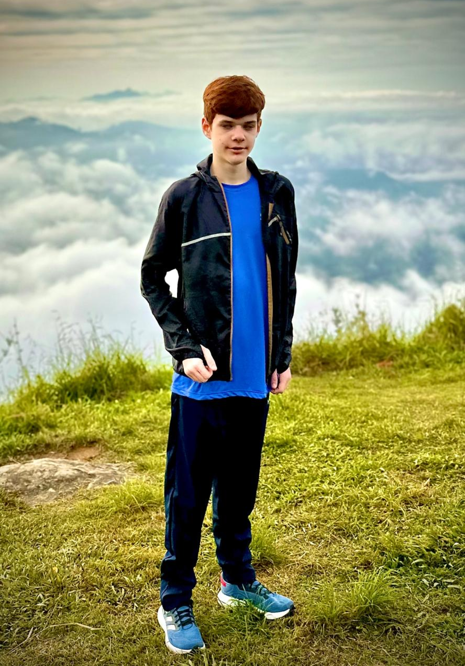

Meet Augusto
Friend who was born partially blind, and lost his vision at age 7
He’s the inspiration behind Fovionics
8

Slide 3
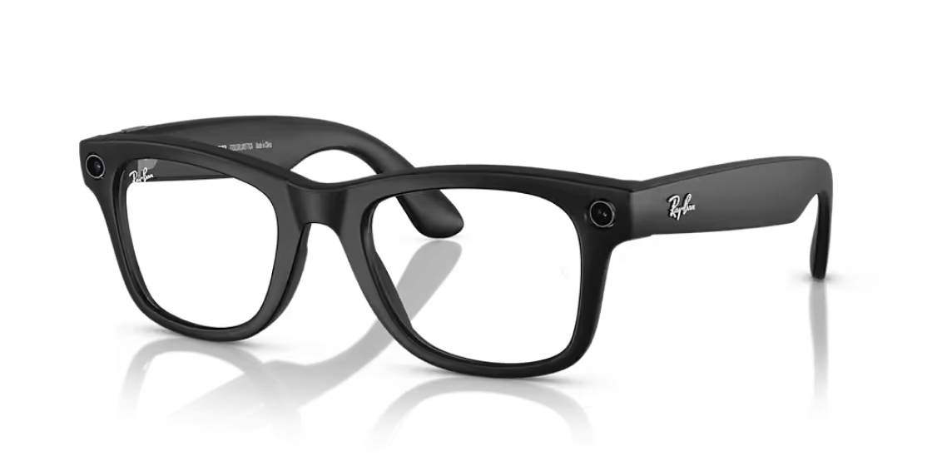
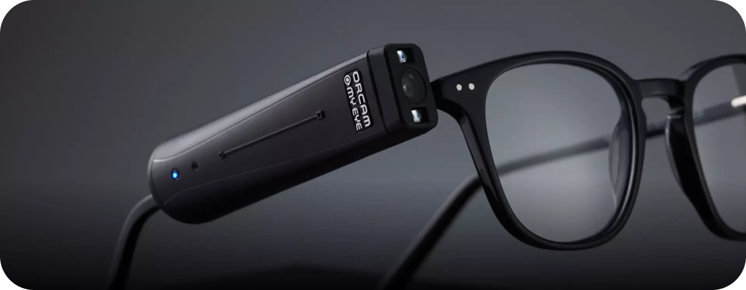

Tools are expensive or not enough
These individuals rely on tools made for the general public, which don’t help with navigation or provide the information the way they need
75% of the visually impaired individuals don’t have access to technology because of high costs
5

Slide 4

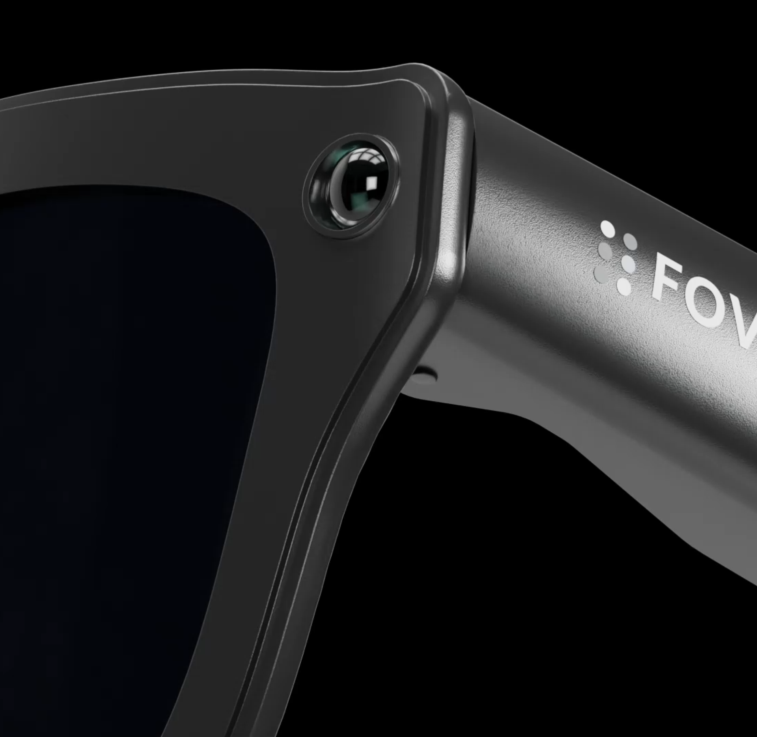
Smart Glasses
So that the visually impaired never have to rely on others again

Slide 5


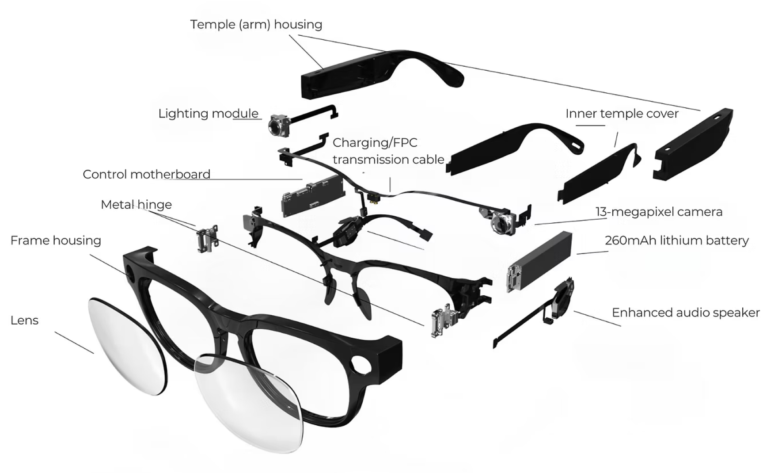
AI Companion (Available on Partner and Proprietary Glasses)
Help users with daily tasks like cooking, reading the mail, recognizing people

Slide 6
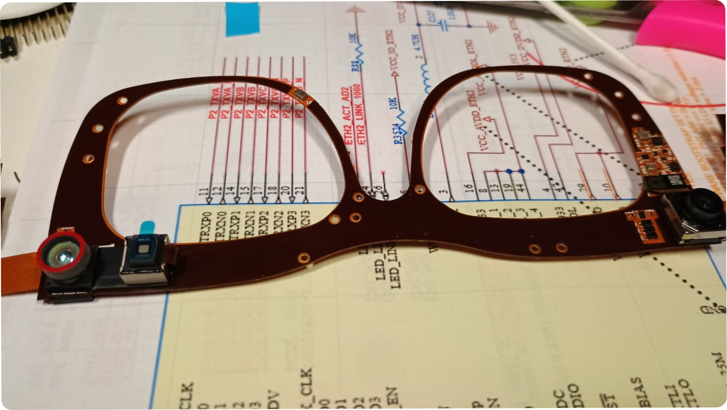
First Smart Glasses in the world with 3D Spatial awareness and Immersive Haptics
Helps users navigate unknown environments through haptics
AI Companion sees and understands depth
Launching 2026

Slide 7
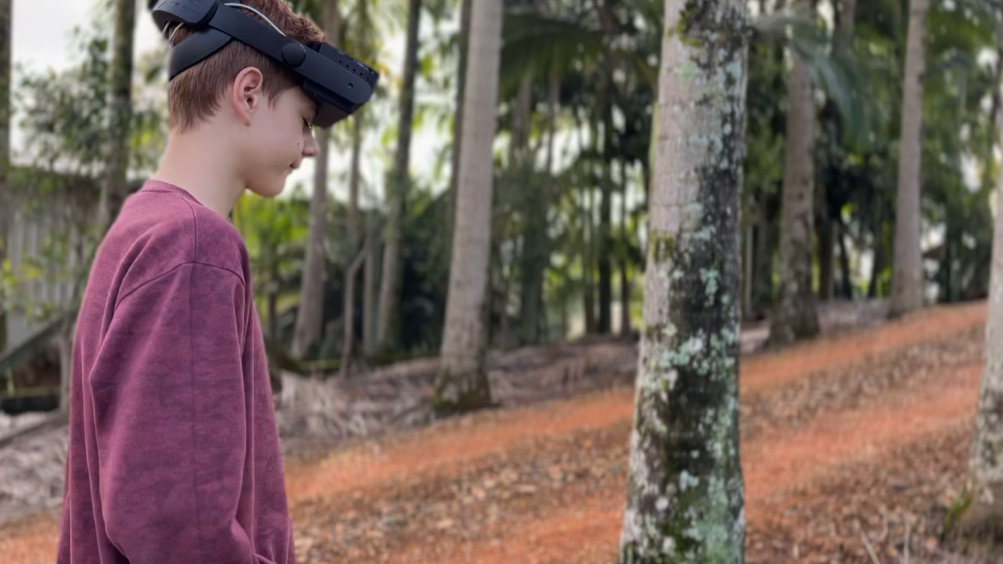



Slide 8
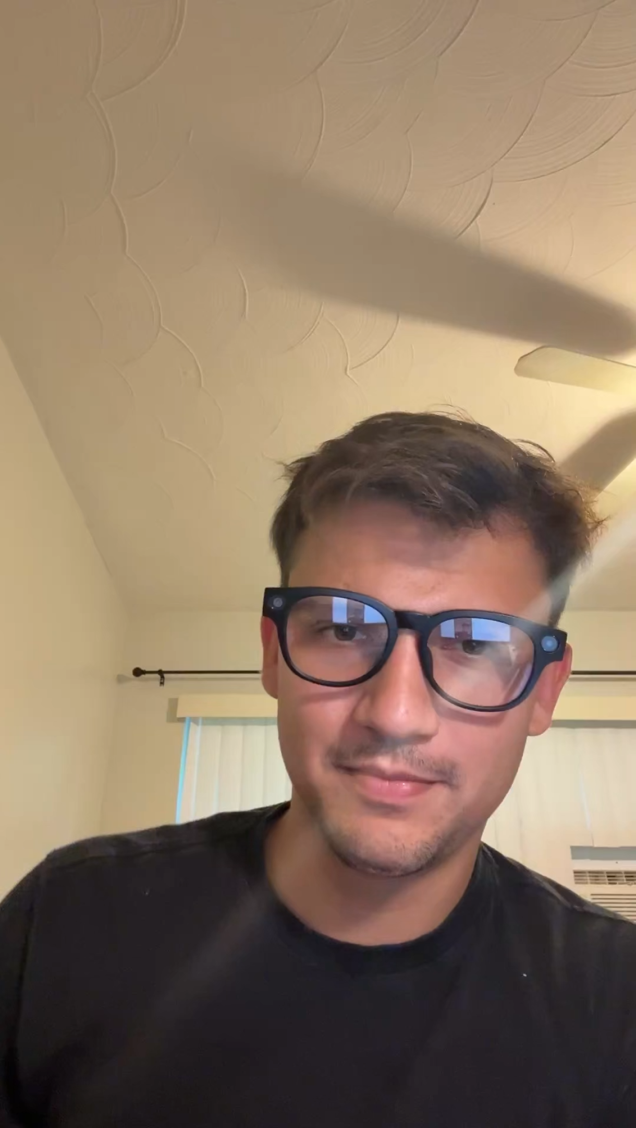
Demo 1
Accessing menus challenge
https://youtube.com/shorts/Fg8HgaUWTJA?feature=share

Slide 9
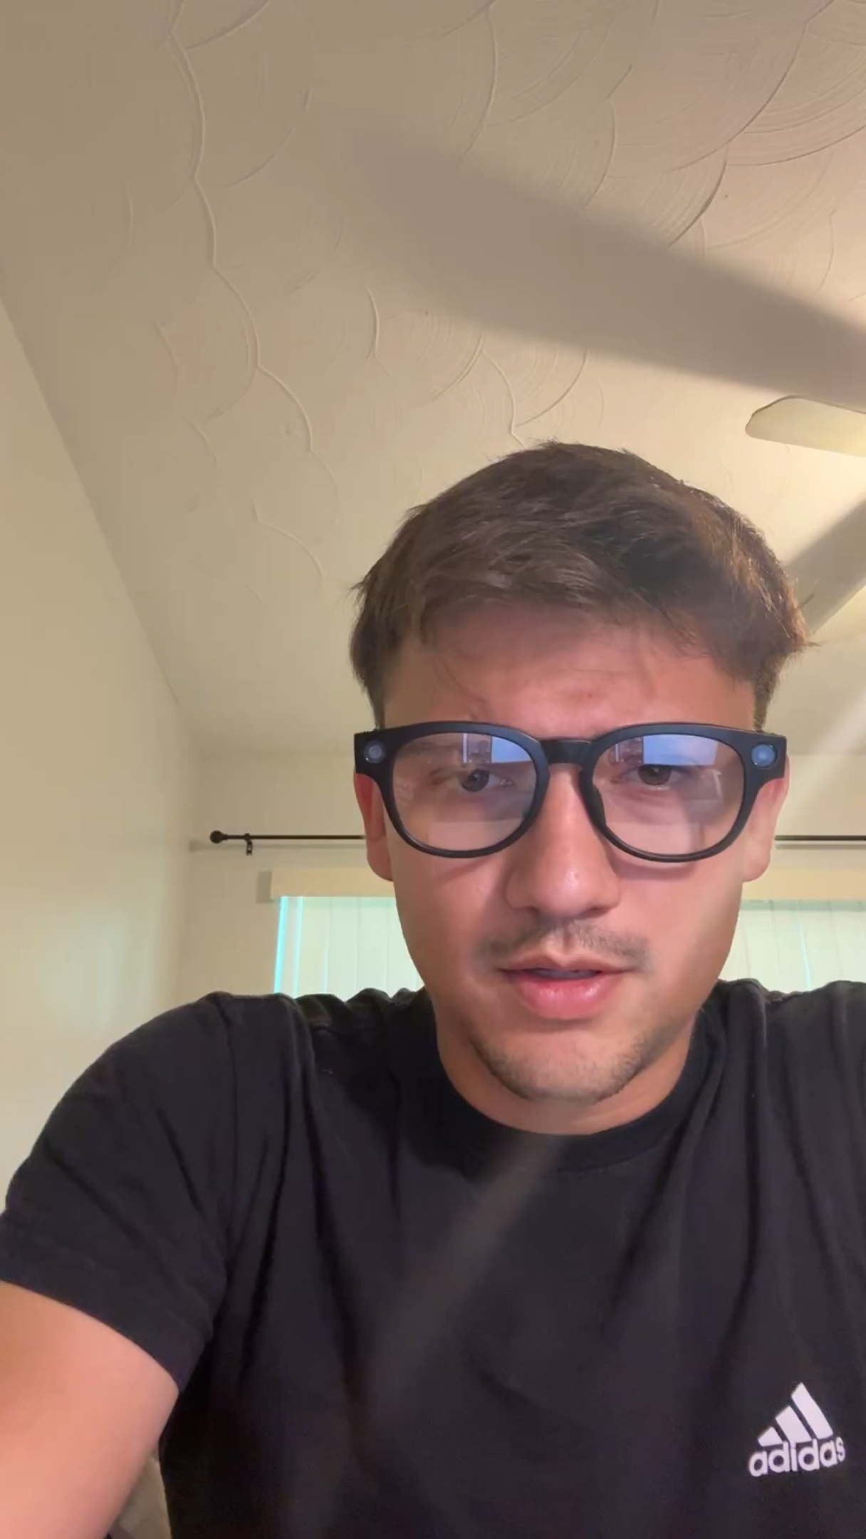
Demo 2
Additional use case
https://youtube.com/shorts/cLhw7kncVQY?feature=share

Slide 10
Tasks (AI Companion)
Wake word detection
Image capture
ToF data capture
Image pre processing (cropping, compressing, partitioning for BLE data transfer)
Image and ToF data transfer
Assembly of image
AI Image analysis
AI ToF Analysis
Capture of audio
Audio pre processing (compression, partitioning for BLE data transfer)
Audio data transfer
AI Audio analysis
Speech to text
Natural Language Generation
Text to Speech
BLE data transfer
Request playing for the user

Slide 11
Technical Goals
We’d like to perform tasks locally to reduce latency and not rely on internet connectivity. As AI advancements are released, we will be able to run models locally one by one.
Running locally today:
Image pre processing
Audio pre processing
Audio and image partitioning for BLE data transfer
Algorithm for object detection of ToF and haptics
ToF pre processing

Slide 12





These numbers will more than double due to the aging population
$130B
$400M
$12B
Direct costs related to vision loss spent in the U.S. per year
Assistive technology & wearable segment
Assistive devices, rehab centers, special education, O&M

Slide 13


Starting with visually impaired individuals, and looking at other markets
Enterprise AR Platform
485M potential Users
Aging Population
760M potential Users
International Travelers
1.3B potential Users
3D Mapping of Cities
Multi trillion dollar market potential for the next few years!

Slide 14

Glasses brands will start adopting this technology
Smart glasses is the future of wearable technologies
Many glasses companies will start to adopt the technology, and we will be pioneers in providing the technology for these companies.

Slide 15

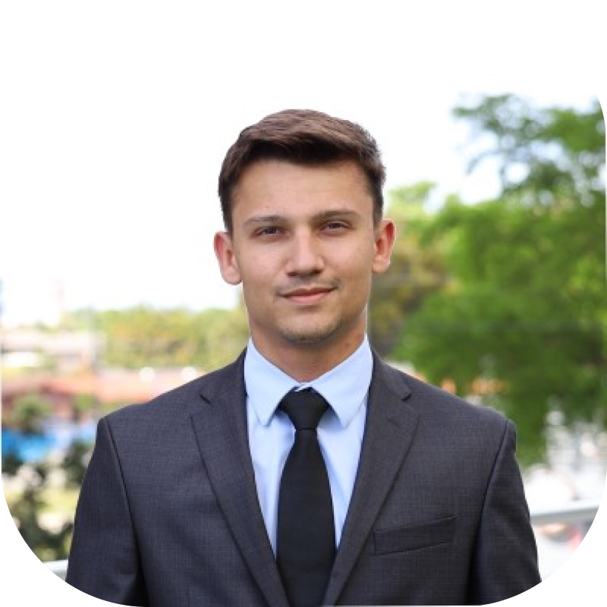

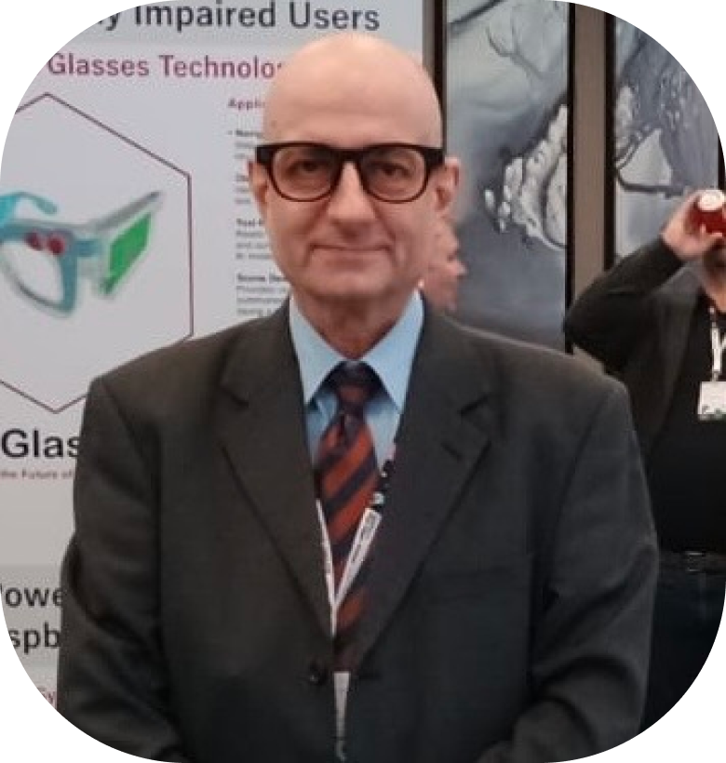






Gabriel Habech, CEO
Oleh Krainyk, CTO
Ioannis, Hardware Developer
Worked at a NASA lab doing materials testing and sensor nano fabrication
Built a successful paper manufacturing business in Brazil
Worked in computer vision for government facilities
Telora alumni, fellowship by Eliam Medina founder of Willing (YC & acquired by Metlife)
Over 30 years of embedded hardware design experience
Sold and delivered 200k units of his own products to over 70 countries
10

Slide 16

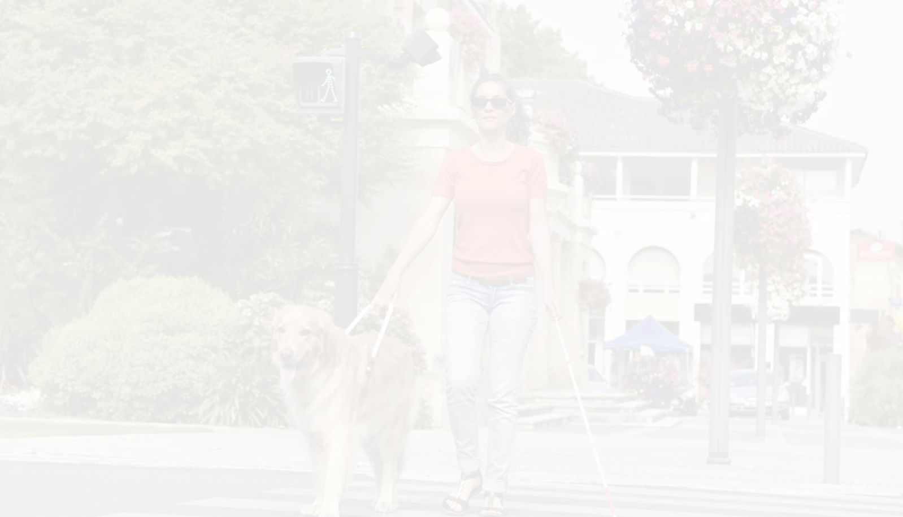
Join us to shape the future of accessible wearables
gabriel@fovionics.com
www.fovionics.com

